Slide 1
Chapter 1
Chemistry: A Science for All Seasons

Slide 2
A Science for All Seasons
Chemistry is the science dedicated to understanding matter and its changes.
    Atoms & Molecules
    Chemical Reactions & Physical Changes
Everything that we physically are, see, touch, eat, think and do involves chemistry.

Slide 3
Science and Technology
Science is the process of seeking an understanding of underlying principles of nature. It involves two facets:
    philosophical (or theoretical)
      Speculation about nature
      Not testable, before scientific/experimental method
    technological (or factual)
      Application of knowledge
      Practical uses

Slide 4
Science and Technology
Technology is the direct application of knowledge to solve problems.
    Fire
    Beer & Wine
Science grew out of natural philosophy or the philosophical speculation of nature.
    Alchemy
    Aristotelian philosophical speculation

Slide 5
Baconian Dream
It was the dream of Francis Bacon (philosopher, lawyer & judge) that science would solve the world’s problems and enrich human life with new inventions, thereby increasing happiness and prosperity.

Slide 6
Carsonian Nightmare
Rachel Carson (biologist) published Silent Spring in 1962.
She proposed that the use of chemicals to control insects was threatening the destruction of all life.

Slide 7
Science
Science has five characteristics. Science is:
  Testable - can observe or detect a variable
  Reproducible - falsifiable
  Explanatory – makes sense of observations
  Predictive – can apply to other situations
  Tentative - can change in light of new data

Slide 8
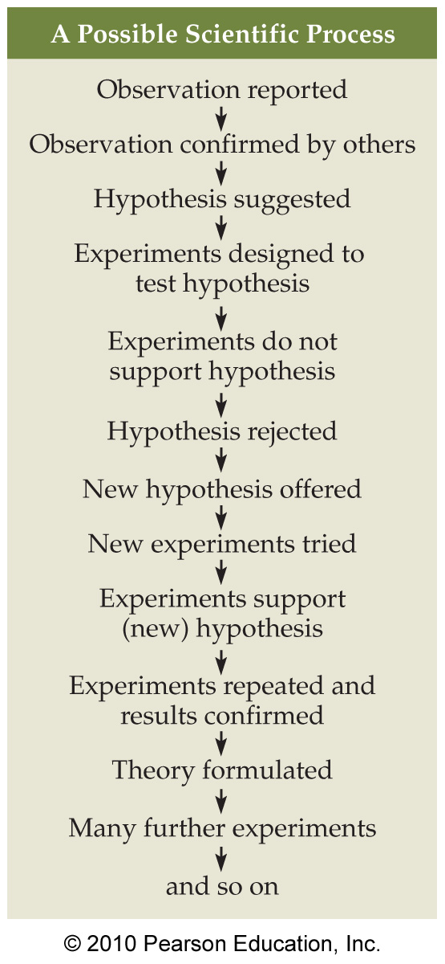
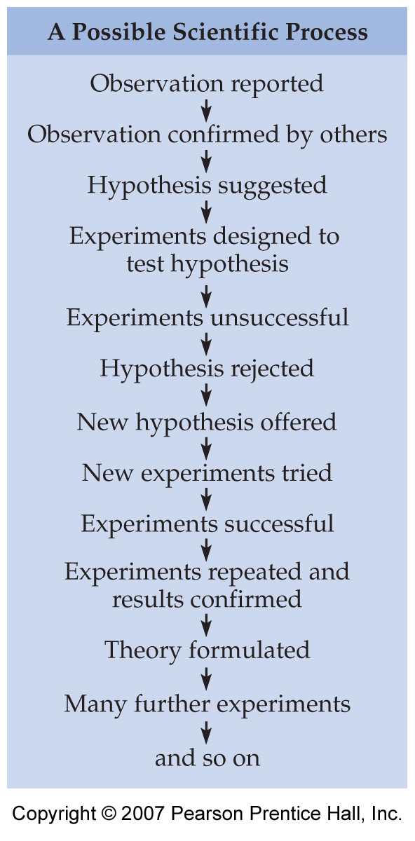

Slide 9
Science
Scientific hypotheses are testable explanations of observed data. These hypotheses are tested by designing and performing experiments where one variable is changed and others held constant.
Hypothesis: HIV causes AIDS
Experiment: Inject single infectious agents into HIV-free subjects and follow up with HIV testing.

Slide 10
Science
Scientific laws summarize large amounts of scientific data and provide descriptions of natural phenomena (e.g., Law of Gravity, Law of Conservation of Mass/Matter, etc.) that are always true and consistent.
  Many scientific laws can be stated mathematically.
  Example: Boyle’s Law (PV = k)

Slide 11
Science
A scientific theory is a set of tested hypotheses that explain natural phenomena. Scientific theories are the best current explanation for natural phenomena. Theories are always tentative and may change as observations of nature change.
    Big Bang theory
    Atomic theory
    Evolution theory

Slide 12
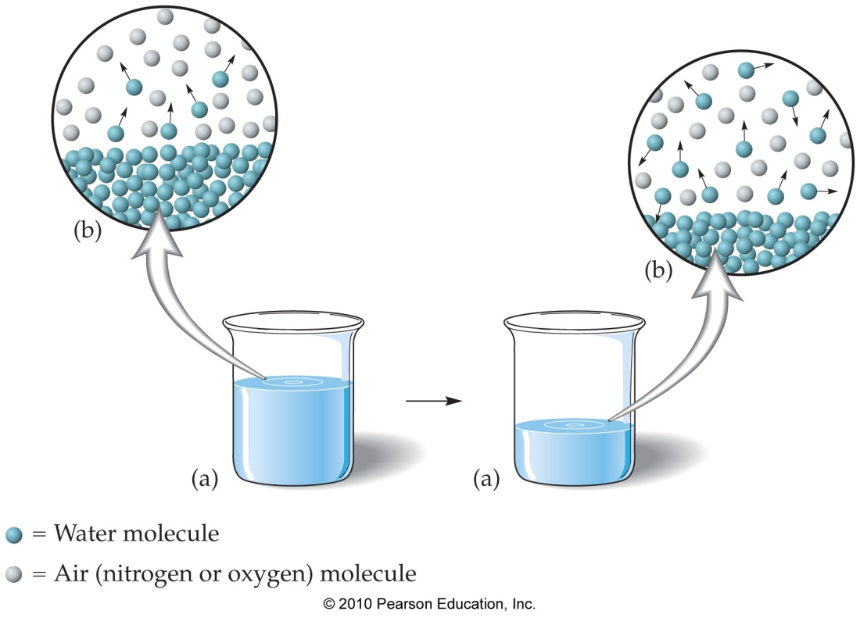
Science
Scientific models are tangible items or pictures used to represent invisible processes.

Slide 13
Molecular Modeling
Molecules are groups of two or more atoms held together by chemical bonds.
Molecular models are three-dimensional representations of molecules.

Slide 14
Limitations of Science
Science is limited to studying that which is observable (detectable) as well as natural processes in which variables can be controlled.
Must be able to change only one variable in a series of experiments.

Slide 15
Science and Technology: Risks and Benefits
Science and technology are interrelated. They involve both risks and benefits.
Risk-benefit analysis involves an estimation called the Desirability Quotient (DQ).
DQ = Benefits
Risks

Slide 16
Solving Society’s Problems: Scientific Research
Applied research involves studying a specific problem in the industry or the environment.
George Washington Carver’s work with peanuts was an example of applied research. In doing so, he developed more than 300 products from peanuts.

Slide 17
Solving Society’s Problems: Scientific Research
Basic research involves the search for knowledge for its own sake.
The findings of basic research can someday be applied to a specific problem in industry or the environment.
Gertrude Ellion’s work with purines and their role in the cell is an example of basic research.

Slide 18
Chemistry: The Study of Matter and Its Changes
Chemistry is the study of matter and its changes.
Matter is anything that has mass and also volume.

Slide 19
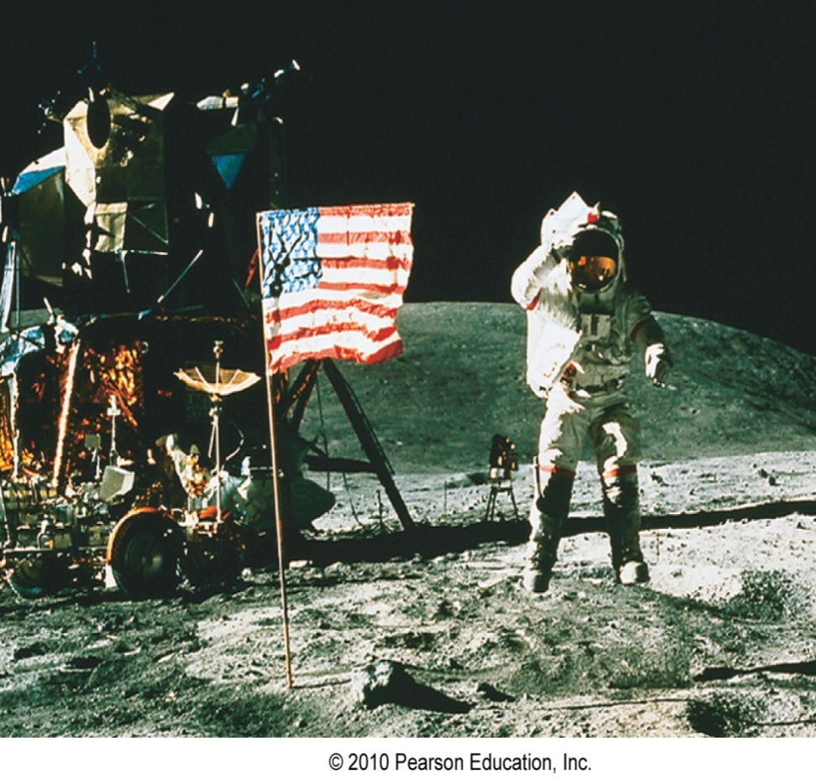
Mass and Weight
Mass is the measure of the amount of matter in an object.
Weight is the measure of the gravitational force for the matter in an object.

Slide 20
Physical Properties
Physical Properties are those properties of a substance that can be observed without changing the substance.
Examples are:
    Color
    Mass (unchanging quantity)
    Weight (dependant on gravitation force)
    Density

Slide 21
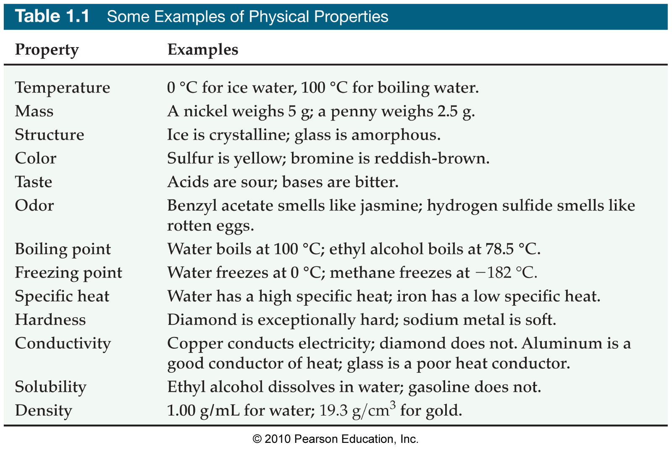
Physical Properties

Slide 22
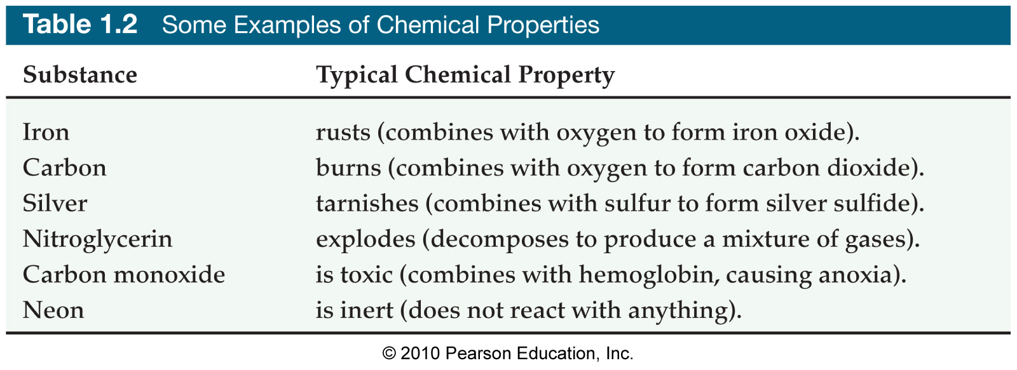
Chemical Properties
Chemical properties are those properties of a substance that can only be studied by forming new substances.

Slide 23
Physical Changes
Physical changes are changes in which the substance is not changed.
Examples are:
    Melting
    Freezing
    Boiling
    Sublimating

Slide 24
Classification of Matter
A solid has a definite shape and volume.
A liquid has a definite volume, but has no definite shape.
A gas has neither definite volume nor definite shape.

Slide 25
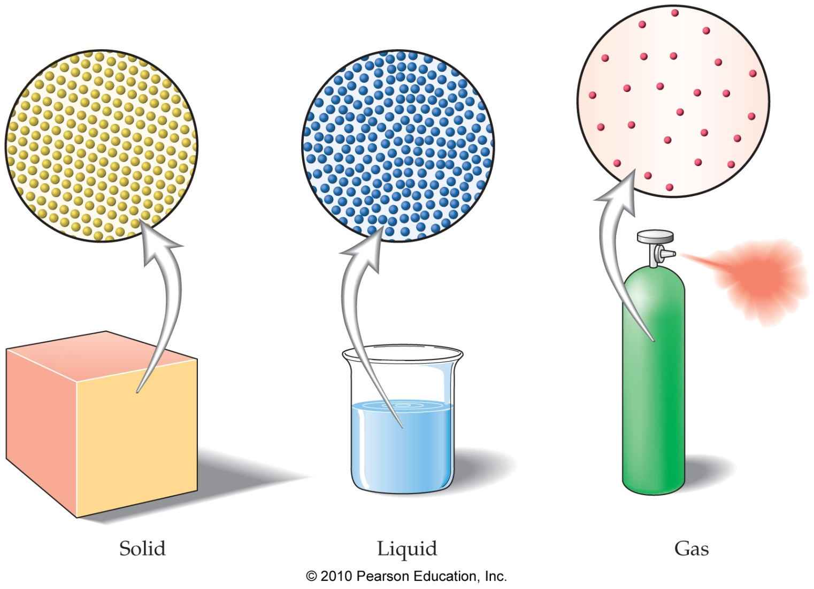
States of Matter

Slide 26
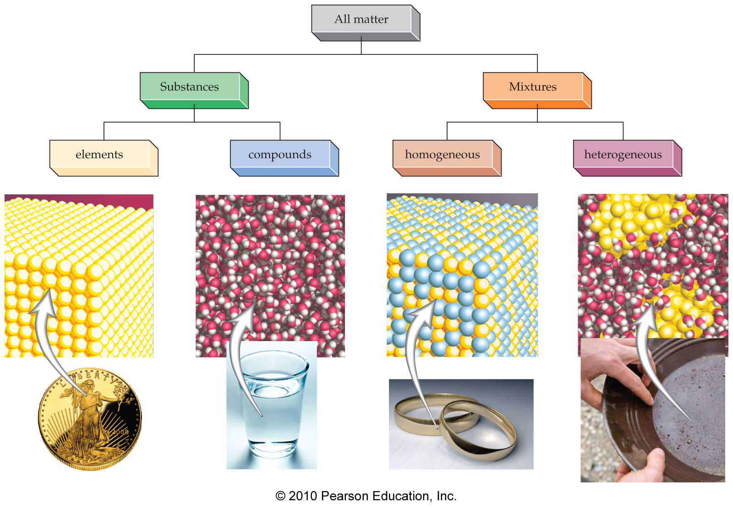
Matter

Slide 27
Elements
Elements are composed of one type of atom.
Atoms are the smallest particle of an element.
Elements are represented by chemical symbols. Examples are: Cl, H, and Mg.

Slide 28
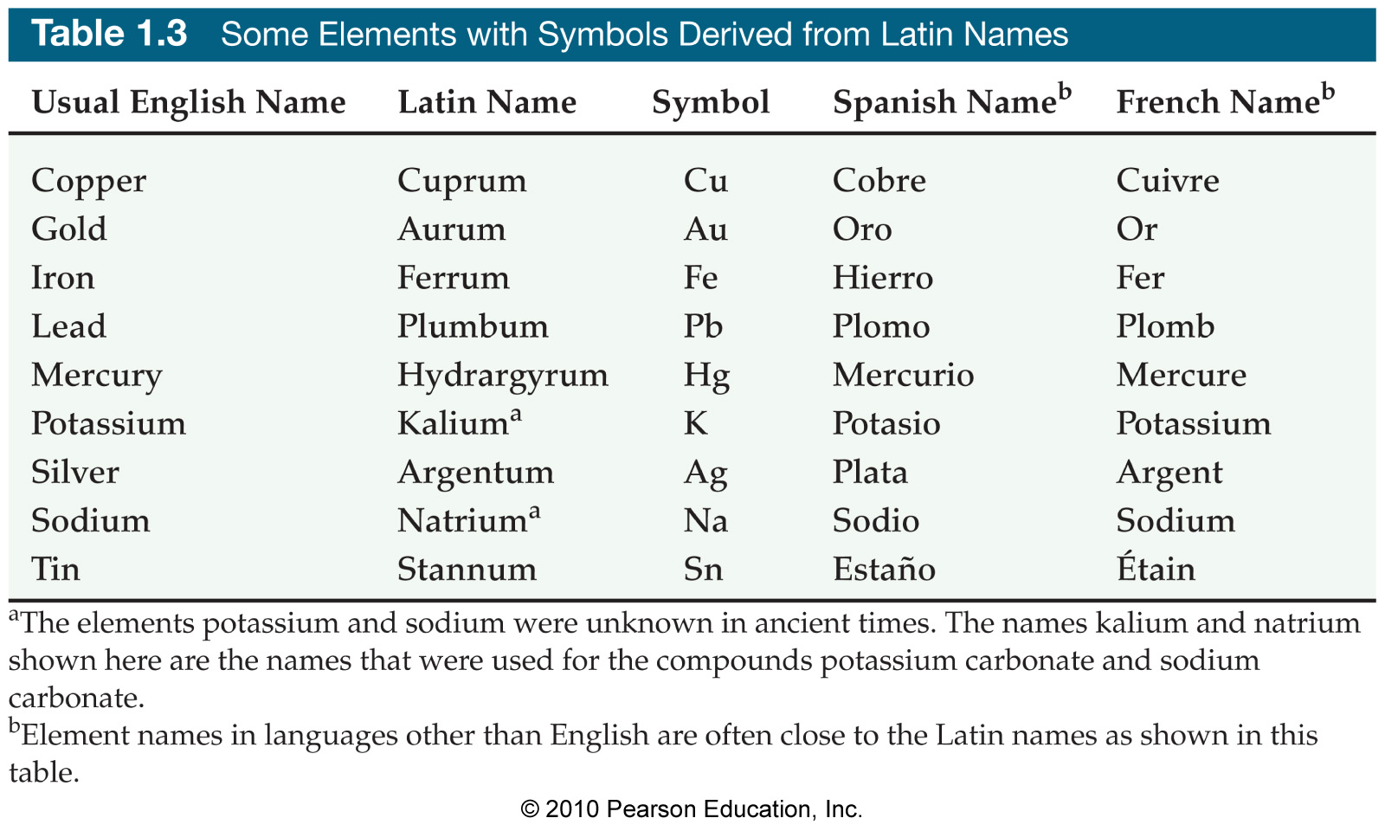
Elements

Slide 29
Compounds
Compounds are made of two or more different elements chemically combined (by chemical bonds).
    CO₂, NaCl and H₂O
Many compounds exist as groups of atoms bonded together as a unit called molecules.
    O₂, N₂, , H₂ and Cl₂

Slide 30
Mixtures
A mixture is a physical blend of two or more substances.
Homogeneous mixtures are uniform in composition.
Heterogeneous mixtures are not uniform in composition.

Slide 31
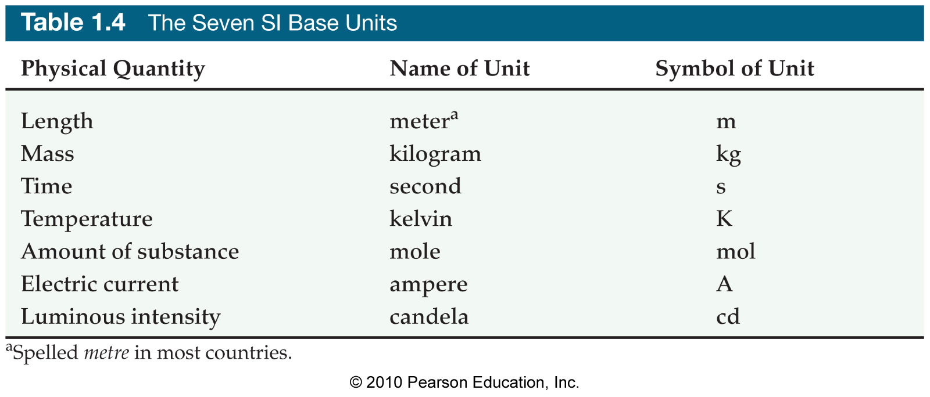
Measurement of Matter

Slide 32
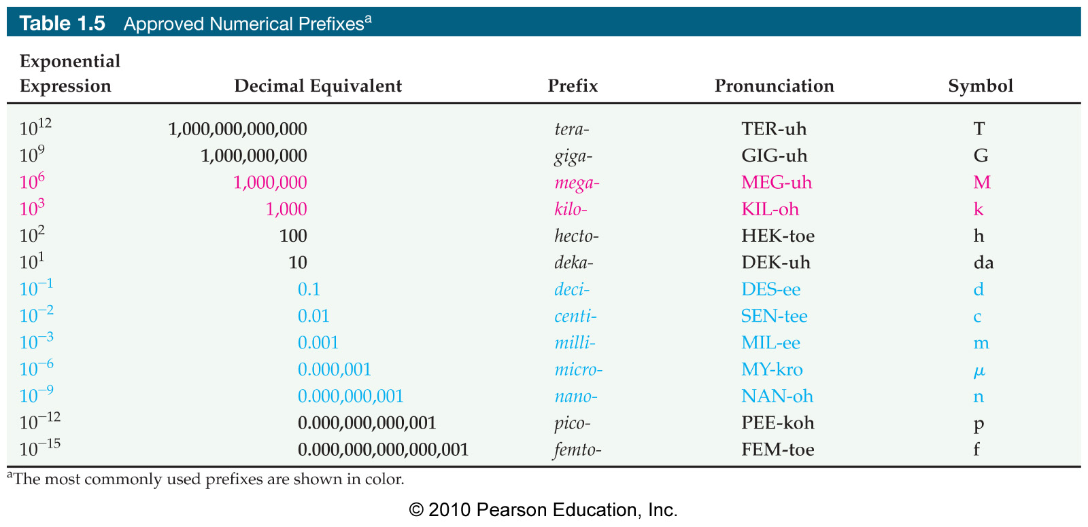
Measurement of Matter

Slide 33
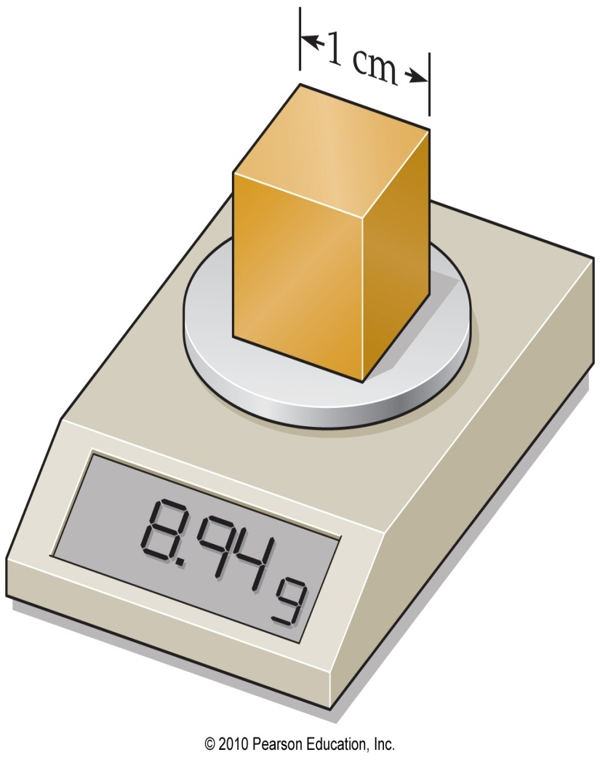
Density
Density is defined as the amount of matter in a given amount of space.
D = m/V
The density of copper is 8.94 g/cm³.

Slide 34
Density: Practice Problem
Calculate the density of a metal sample with a mass of 18.96 g and a volume of 4.31 cm³.
D = m/V
= 18.96 g/4.31cm³
= 4.40 g/cm³

Slide 35
Energy: Heat and Temperature
Energy is the ability to do work or transfer heat.
Energy exists in two major forms:
    Potential energy is stored energy.
    Kinetic energy is energy in motion.

Slide 36
Heat vs. Temperature
Heat is energy that is transferred from hotter objects to cooler objects.
Temperature is the average kinetic energy (vibration motion) of an object.

Slide 37
Units of Heat
Heat energy is often measured in calories or joules.
  One calorie (cal) is the amount of heat required to change the temperature of 1.00 g of water 1.00 ºC.
  A calorie is 4.184 joules (J).
    1 cal = 4.184 J

Slide 38
Food Calories
A food calorie (Cal, “C” is capitalized) is actually a kilocalorie.
    1 Cal = 1 kcal = 1000 cal = 4184 J

Slide 39
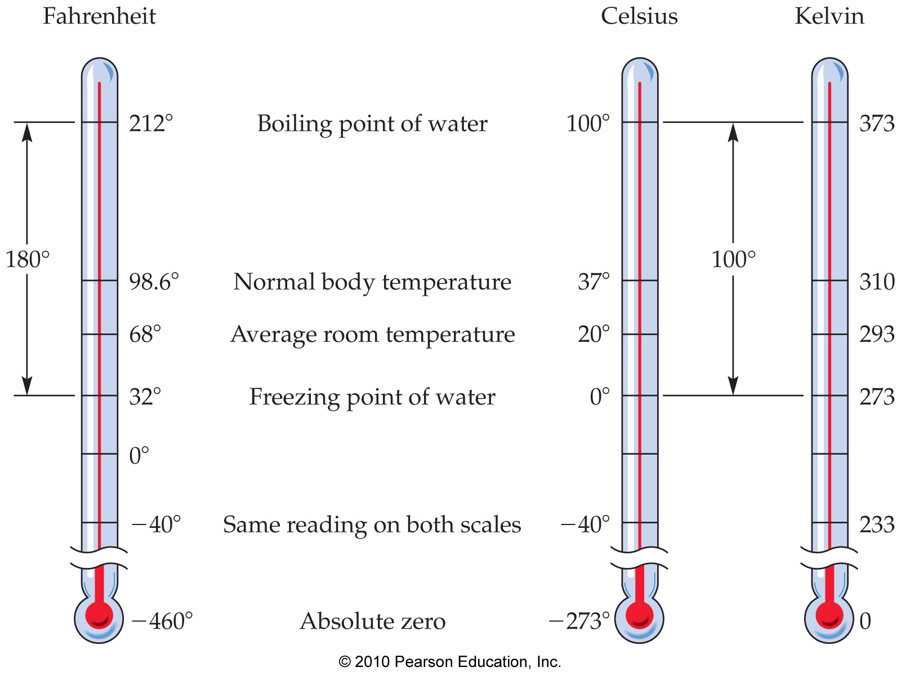
Temperature Scales

Slide 40
Temperature Conversion
  K = ºC + 273.15
  ºC = K - 273.15
  ºC = (ºF – 32) / 1.8
  ºF = (ºC x 1.8) + 32

Slide 41
Validity
You can test the validity of a claim by using the FLaReS test:
  Falsifiability
  Logic
  Replicability
  Sufficiency
  If a claim passes all four FLaReS tests, then it may be true. Though it can still be proven false. If it fails even one of the tests, it is likely to be false.

